Slide 1
Twitterazzi
By:
Ankita, Dave, Hamish, John, Kaayin and Stuart

Slide 2
Overview
About
Architecture Diagram
ETL Process
Dashboard
Arc Diagram
WordCloud

Slide 3
About
Analysis of top 50 twitter user profiles which includes Politicians, Bollywood Actors , Hollywood Actors and well-known celebrities or organisations.
Dashboard: stats on number of likes ,tweets, retweets, @mentions and #Hashtags per user.
Word Cloud: covers the top 250 Hashtags of the user inside the dataset
Arc Diagram: illustrates which of the Top 50 users are talking to each other

Slide 4
Walk Through

Slide 5
Analysis Fun Facts!
Justin Bieber has more total “Likes” than Donald Trump, but Ariana Grande beats both of them at 203m
Barack Obama has a tweet that hit almost 5 million likes!!
Donald Trump is the most prolific tweeter at an average of 30 per day

Slide 6
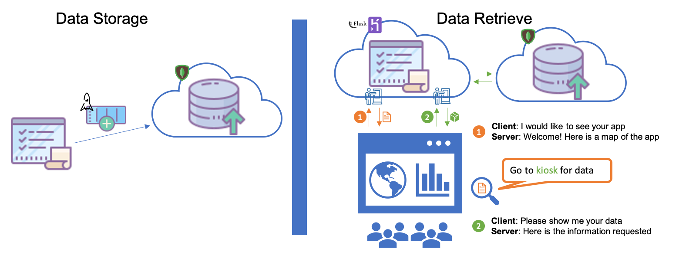
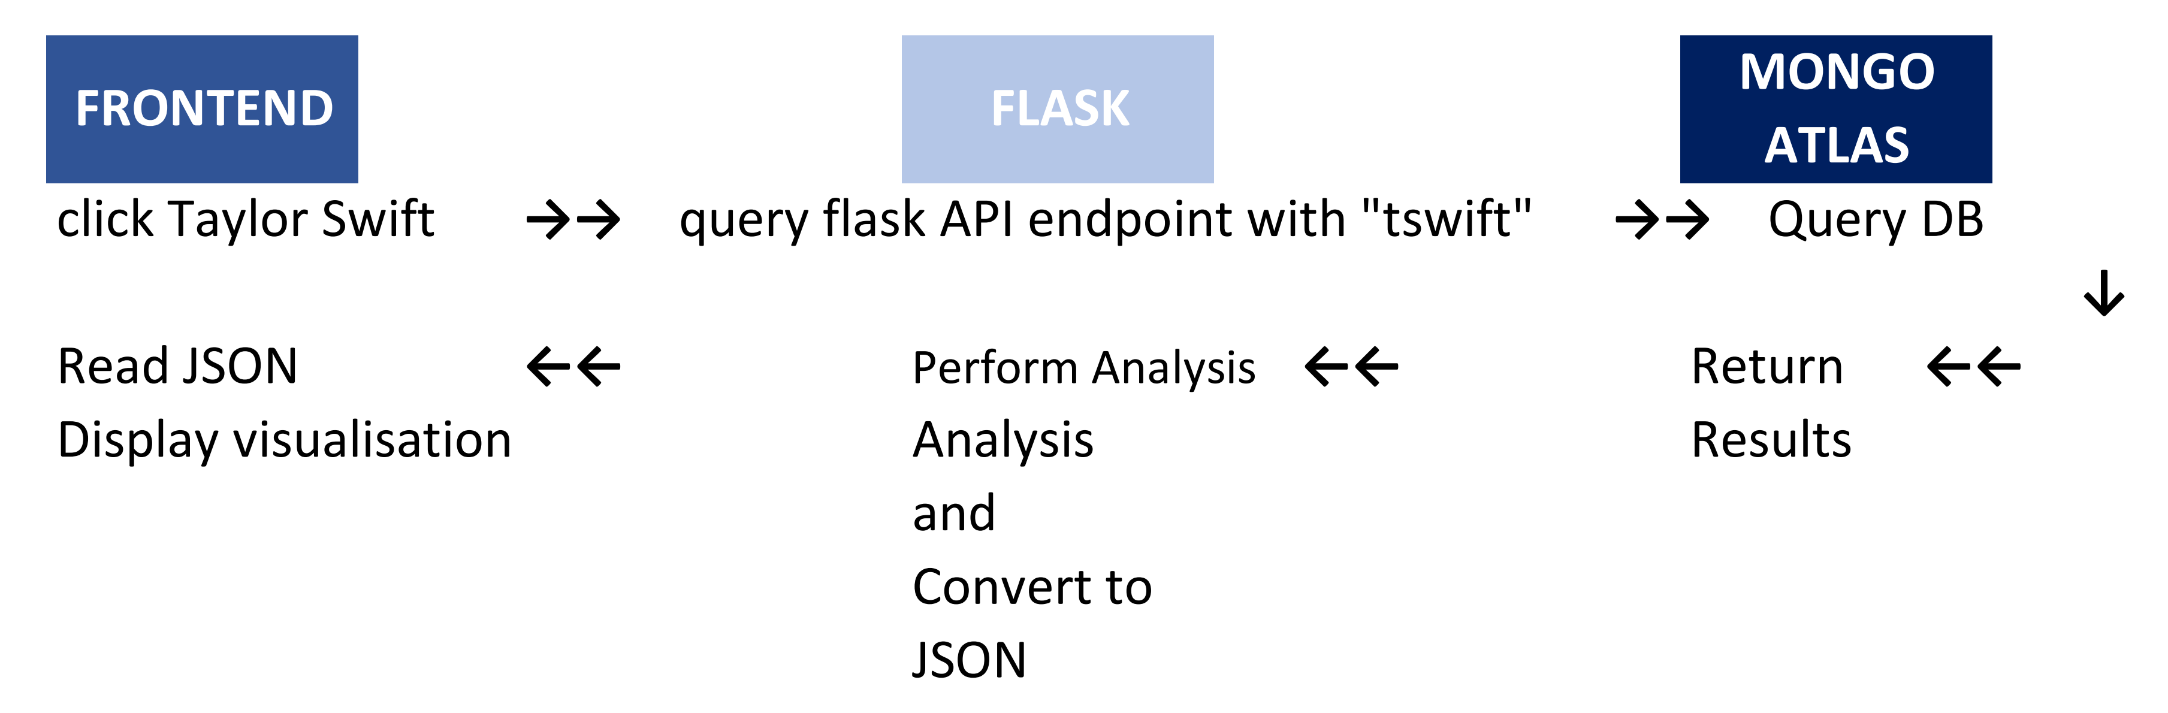
Architecture

Slide 7
Back End

Slide 8
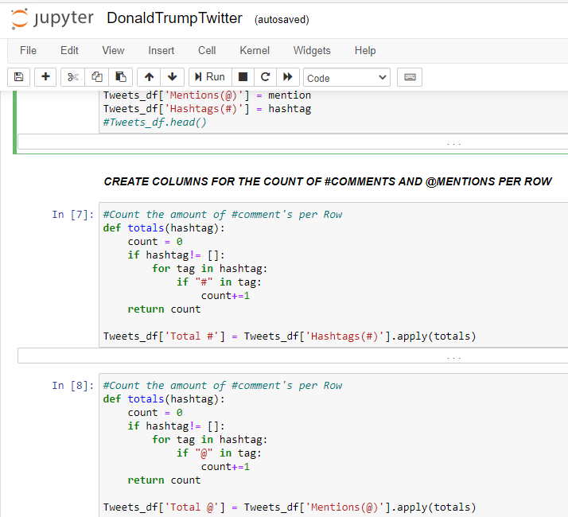
ETL Process
Each influencer, had the same 3 csv files, so each file had to be renamed to be called upon.
The process was:-
-Rename the csv files to identify influencer
-Extract all relevant columns to create a new data frame
-Separate Date and Time
-Read the next csv file belonging to the same influencer
-Extract all relevant columns to create a new data frame
-Merge this new data frame with the first data frame created
-Read the final csv file belonging to the same influencer
-Extract all relevant columns to create a new data frame
-Merge this new data frame with the first data frame created
-With this new merged data frame, add any relevant data to apply to all
-Clean for visual purposes (drop if need, re-order, correct index, etc)
-Save file
-Repeat for each influencers

Slide 9
Mongo DB / Atlas
Mongo was used due to capacity constraint in Heroku
Only 10k rows in free tier in Heroku, 512mb on Atlas
NoSQL / JSON format
Queries were easier to write than anticipated
Query results were mainly loaded into Pandas for working

Slide 10
FLASK
Flask App Contains several key routes:
Web Routes:
Root
/wordcloudpage/
/ARC_Diagram/
API Routes:
/api/dashboard/ (dynamic)
/api/dashboard/scatter (dynamic)
/api/identitylist/ (static)
/api/wordcloud/ (dynamic)

Slide 11
Front End

Slide 12
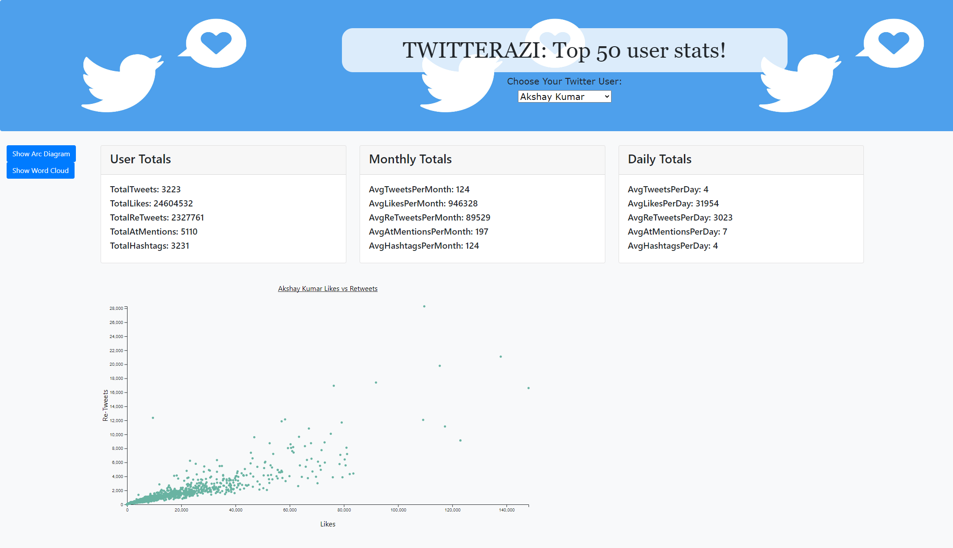
Dashboard
This visualization includes a dropdown of top 50 twitter users which on selection of a user displays the total number of Likes, Tweets, @Mentions, #Hashtags per day.
A graph is also included which plots retweets vs likes.
Buttons available to navigate to the Word-cloud and Arc diagram pages.

Slide 13
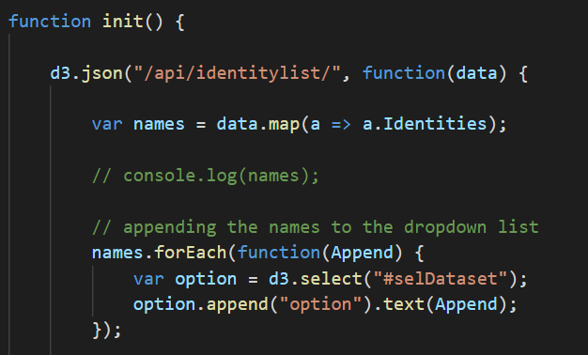
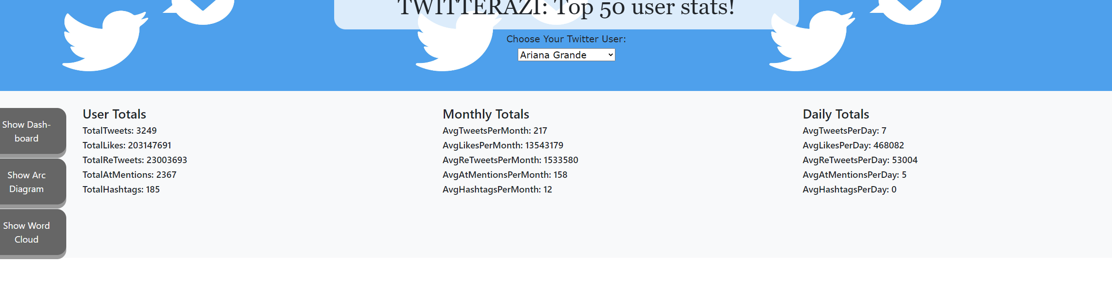
Dropdown
Our dropdown menu was based on the code from the Plotly assignment
Similarly we included an 'onchange' event to handle the user select in the dropdown
This event launches 2 functions which call the required endpoints with d3.json
<-- Early version of our dashboard

Slide 14
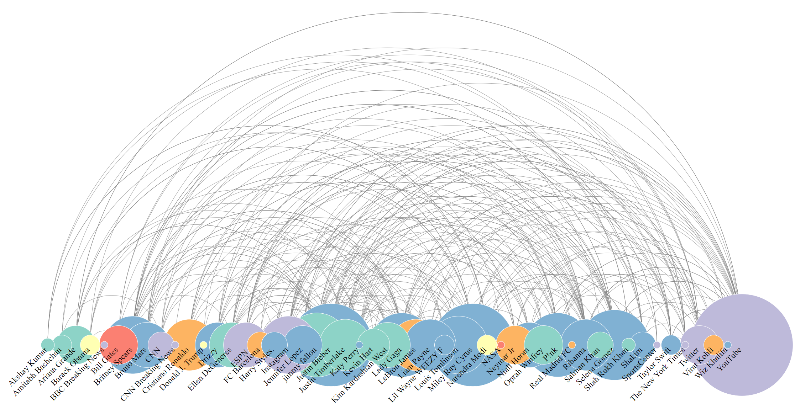
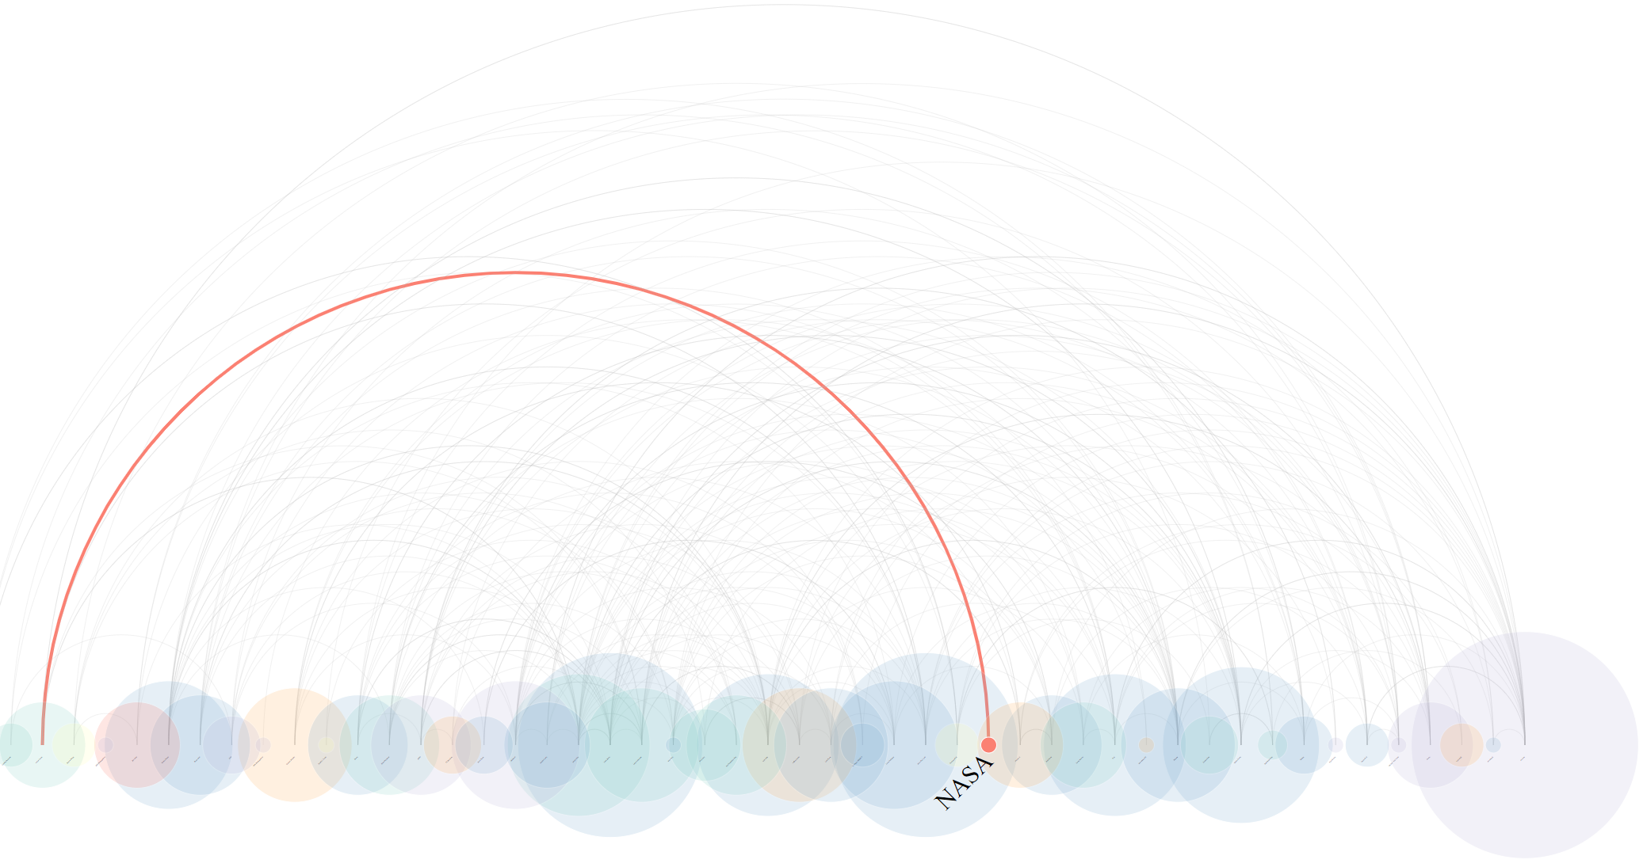
Arc diagram
An Arc Diagram uses a one-dimensional layout of nodes which increase in size in relation to the number of ‘unique’ connections or (@mentions) between one of the other Top 50 users.
Circular arcs represent these unique connections from ‘source’ e.g. “NASA” to ‘target’ “@arianagrande” in the following tweet:
"@greekjupiter @HBO @ArianaGrande We understand that you might need some space.
ðŸŽ¶ Itâ€™s like youâ€™re the universe and weâ€™re N-A-S-A ðŸŽ¶
We can't make any promises for the future, but our @MarsCuriosity rover did play the first song transmitted from another planet on Mars. Check it out: https://t.co/5D6TUgA2IA"

Slide 15
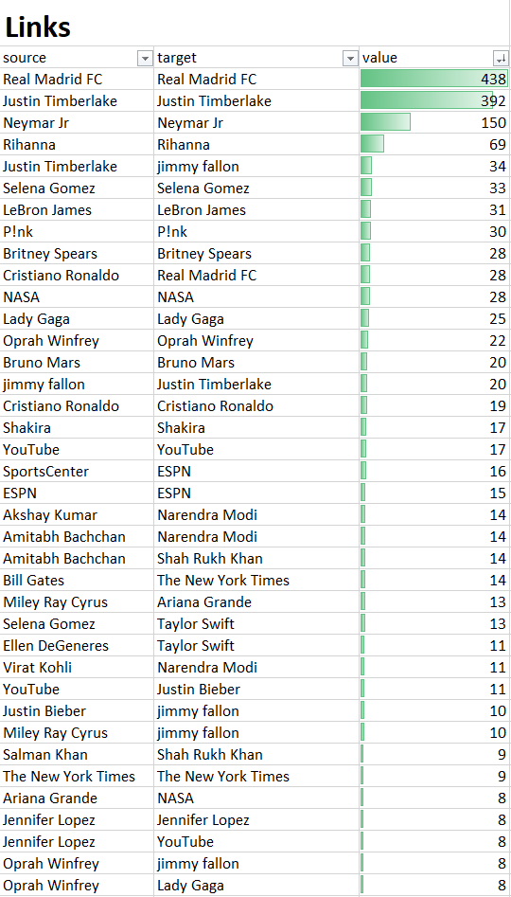
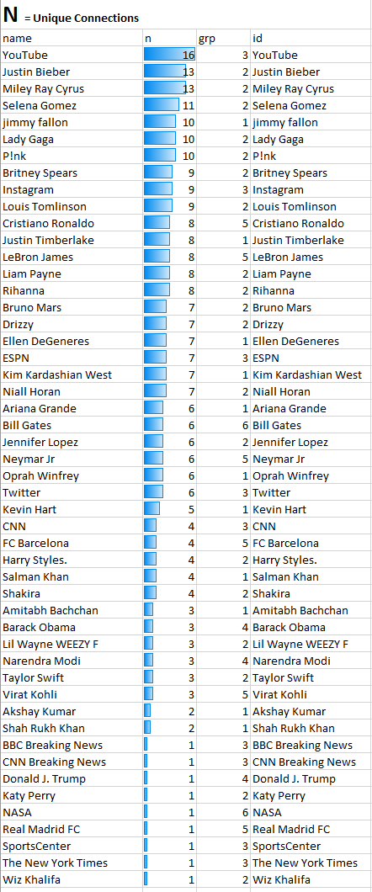
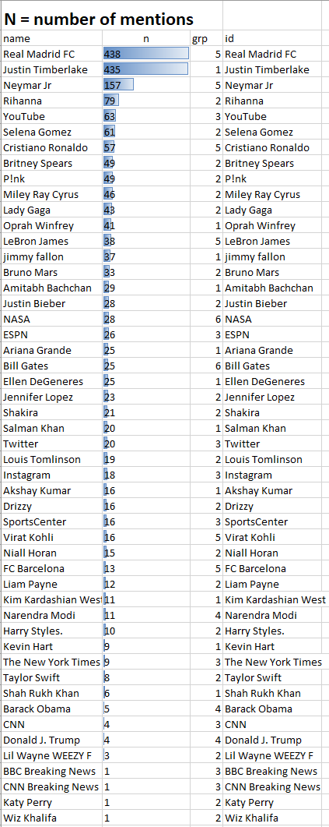

Slide 16
Word Cloud
A word cloud is comprised of a ‘cloud’ of words of varying sizes depending on their frequency of occurrence in a body of text
[{"text":"study","size":40},{"text":"motion","size":15},{"text":"forces","size":10}...]
In our flask app:
One endpoint for the data
One endpoint for rendering the html page

Slide 17
Final considerations
Wanted our app to be more javascript oriented
Final data for wordcloud wasn't as clean as desired
Database – flask – javascript connection is quite labour-intensive!
As the repo grew, discipline was required with housekeeping, otherwise files and folders get out of control, and GIT goes out of sync

